Slide 1
Object-Oriented Programming using JAVA LESSON11 – Chapter 8: Object and Classes + Application of OOP
IPRC South, Huye – Campus
ICT Department
KANIMBA Patrick

Slide 2
Outline
Class vs. Object
Java Field Variables
Java Constructor
Java Method

Slide 3
Java Classes

Slide 4
Class vs. Object
When we talk about a class we're talking about the code itself, the code that sits around doing nothing.
When you put the code to work it's an object.
When you create a class, you're writing code to do a particular job. That job might be to do with an employee, but not the company's sales figures at the same time.

Slide 5
ExamDetails.java
Create a java project called Object
Call the package exams, and then change the name of the Main method to ExamDetails.

Slide 6
ExamDetails.java
package Exams;
public class ExamDetails{
public static void main(String[] args){
}
}

Slide 7
StudentResults.java
Next, we Create a java class to handle the data exam

Slide 8
Java Field Variables
The variables you set up inside of methods are only available to those methods. They are not available to other methods. They are said to have local scope.
However, you can set up variables outside of methods that all the methods in your class can see. These are known as Field variables (or Instance variables).

Slide 9
StudentResults.java
Package Exams
public class StudentResults{
String Full_Name;
String Exam_Name;
String Exam_Score;
String Exam_Grade;
{

Slide 10
Java Field Variables
We're setting up four string variables (four string fields).
As the names of the fields suggest, the string will hold a person's name, an exam name, a score, and a grade.
These four fields will be available to all the methods that we write in this class, and won't be local to any one method. They are said to have global scope.

Slide 11
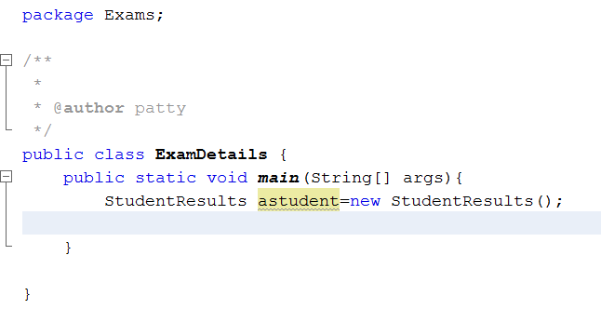
Java Field Variables
To see just how global they are, click back on to your ExamDetails class, the one with the main method. Add the following line of code to create a new object from your StudentResults class:

Slide 12
Java Field Variables
This is the same as we did in the previous section - used the new keyword to create a new object. The name of the object will be aStudent, and it is of type StudentResults, which is our class.
On the next line, type the name of the variable (aStudent), followed by a dot. As soon as you type the dot NetBeans display a popup list of methods and properties available to your object as in the next slide:

Slide 13
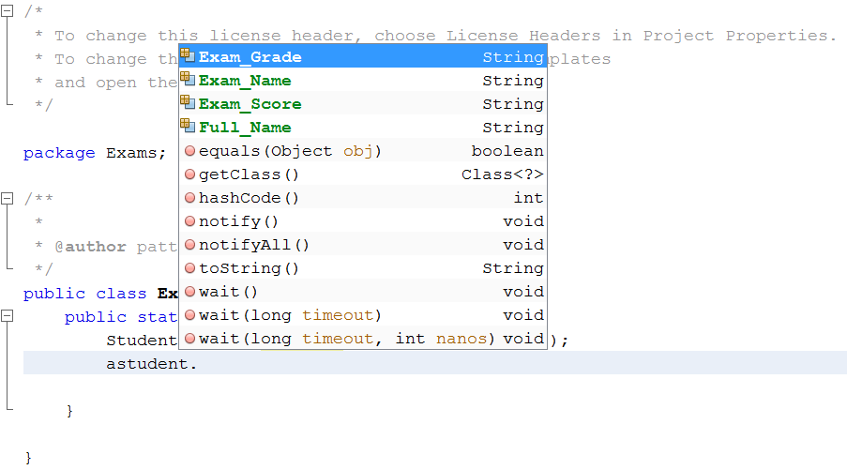
ExamDetails.java

Slide 14
ExamDetails.java
package Exams;
public class ExamDetails {
public static void main(String[] args){
StudentResults astudent=new StudentResults();
astudent.Exam_Name="OOP USING JAVA";
String exam=astudent.Exam_Name;
System.out.println(exam);
}
}

Slide 15
StudentResults.java
package Exams;
public class StudentResults {
String Full_Name;
String Exam_Name;
String Exam_Score;
String Exam_Grade;
}

Slide 16
Java Field Variables
However, it's not a good idea to make field variables global like this.
You tend to lose track of just what values are being held in them, and it therefore makes debugging your code a lot harder. It's considered good coding to narrow the scope of field variables.
To make a field variable available only to a particular class, you add the Java keyword private just before the field declaration. Change the code in your StudentResults class as in the next slide:

Slide 17
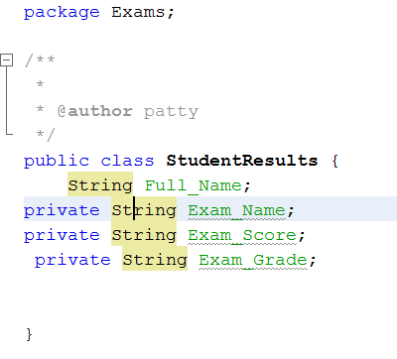
StudentResults.java

Slide 18
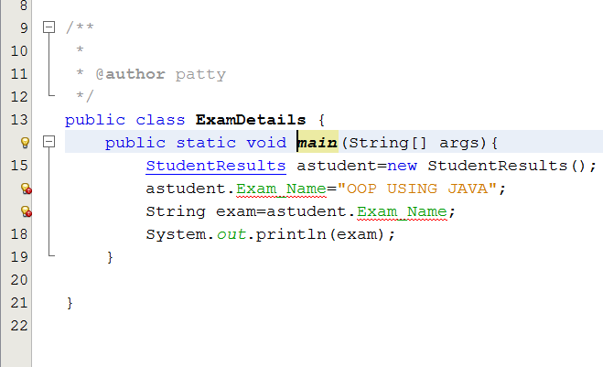
Java Field Variables
Now, only code within the StudentResults class can see these field variables. To check, go back to your main method. You should see some warnings and red underlines:

Slide 19
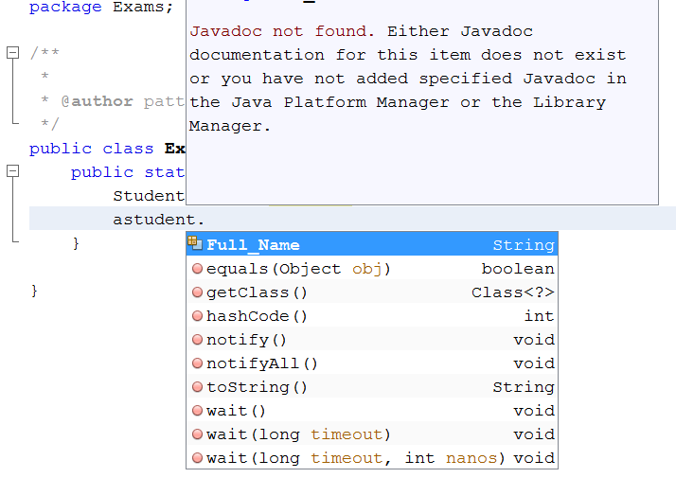
Java Field Variables
Delete the three lines at the bottom. Type aStudent and then a dot again to see the NetBeans popup list:

Slide 20
Java Field Variables
As you can see, the four field variables have now vanished. They have vanished because they no longer have global scope, and therefore can't be seen from the ExamDetails class.

Slide 21
Java Class Constructor
Because we've made the field variables private, we need another way to assign values to them.
One way to do this is with something called a constructor.
This is a method you can use to set initial values for field variables.
When the object is created, Java calls the constructor first.
Any code you have in your constructor will then get executed. You don't need to make any special calls to a constructor method - they happen automatically when you create a new object.

Slide 22
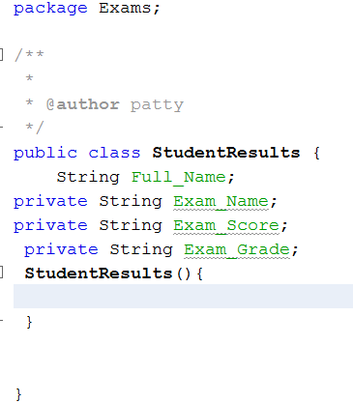
Java Class Constructor
Constructor methods take the same name as the class.

Slide 23
Java Class Constructor
So the name of the constructor is StudentResults.
This is exactly the same name as the class itself.
Unlike normal methods, class constructors don't need a return type like int or double, nor any return value.
You can, however, pass values over to your constructors.

Slide 24
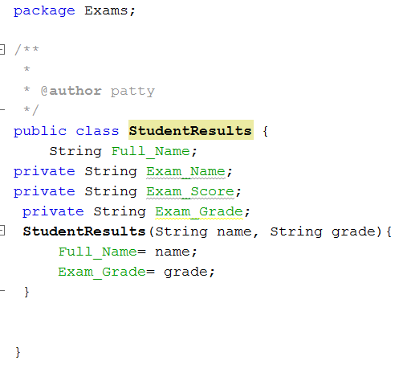
StudentResults.java

Slide 25
Java Constructor
Here, we've added two String variables to the round brackets of the constructor.
Inside the curly brackets we've assigned these values tothe Full_Name and Exam_Grade fields.
When you create a new object, you'd then need two strings between the round brackets of the class name:
StudentResults aStudent = new StudentResults( "Bill Gates", "A" );
When the object is created, the values "Bill Gates" and "A" will be handed over to the constructor.

Slide 26
Java Constructor
However, it's a good idea to just set some default values for your field variables.
These values will then be assigned when the object is created.

Slide 27
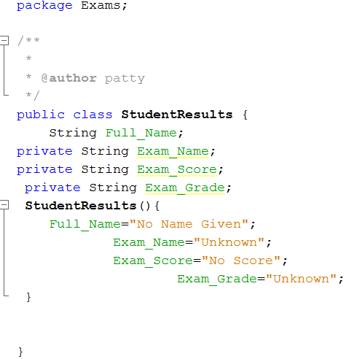
StudentResults.java

Slide 28
Java Constructor
All four of our field variables will now have default values whenever a new StudentResults object is created.
Notice that we now don't have anything between the round brackets of the class constructor.

Slide 29
Accessing Class Variables
Now that we have some default values, we can add a method that sets some different values for them.
Add the method in the next slide to your StudentResults class.

Slide 30
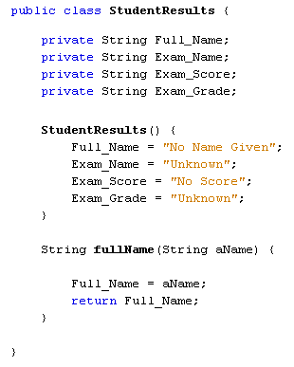
StudentResults.java

Slide 31
Accessing Class Variables
This new method is called fullName, and has a String variable called aName between its round brackets.
The method doesn't do a great deal, and is here for simplicity's sake.
We could have had the method do more work, like checking it for errors, making sure it's proper case, checking for blank strings, etc.
But the important point is that it sets a value for the Full_Name field, and returns this field as a value.
When we call this method, it will overwrite the default value for Full_Name and insert a new value.
Whatever is in the variable aName will be the new Full_Name value. Let's see it in action.

Slide 32
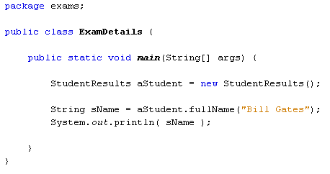
Accessing Class Variables
Go back to your ExamDetails class. Add the following two lines:
String sName = aStudent.fullName("Bill Gates"); System.out.println( sName );

Slide 33

Output

Slide 34
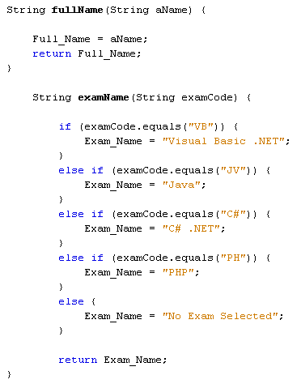
StudentResults.java

Slide 35
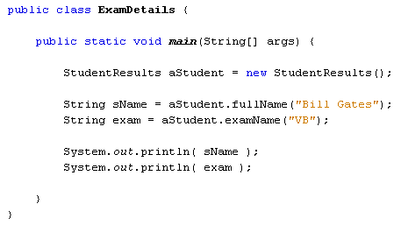
ExamDetails.java

Slide 36
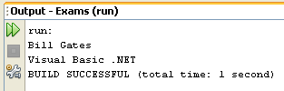
Output

Slide 37
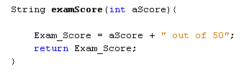
More Java Class Methods
Now, we now have a student name and an exam name.
Both are stored in the field names in the StudentResults class.
We can now add an exam score.
Add the following new method to your class, just after your examName method:

Slide 38
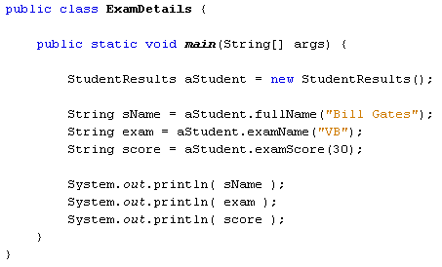
More Java Class Methods
In your ExamDetails class, add the following line:
String score = aStudent.examScore(30);
So we call the new examScore method and hand it a value of 30. The value in the Exam_Score field is returned, and then stored in a string variable that we've called score.
Add a new print line method so that your code looks like ours below:

Slide 39
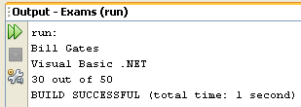
Output

Slide 40
More Java Class Methods
So we have the student name, the exam name, and the score out of 50. We can now add a grade to the output.
We'll use a single letter for the grade: A, B, C, D, or E.
If the students gets 41 or over, we'll an award an A; if the score is between 31 and 40, the grade will be B; for a score of 21 to 30 a C grade will be awarded; a D grade is between 11 and 20; and an E is for scores between 0 and 10.

Slide 41
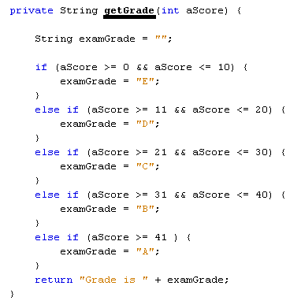
StudentResults.java

Slide 42
More Java Class Methods
To get the grade, we'll set up another method inside of the StudentResults class. We'll use this to get the grade. Add the following method just above the getGrade method (though you can add it below, if you prefer: it doesn't make any difference to Java!):
String examGrade(int aScore) {
Exam_Grade = this.getGrade( aScore) ; return Exam_Grade; }

Slide 43
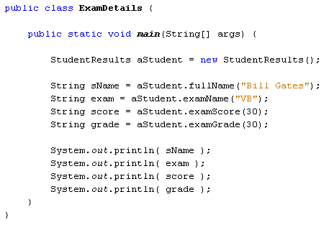
ExamDetails.java

Slide 44
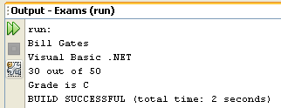
Output

